Slide 1


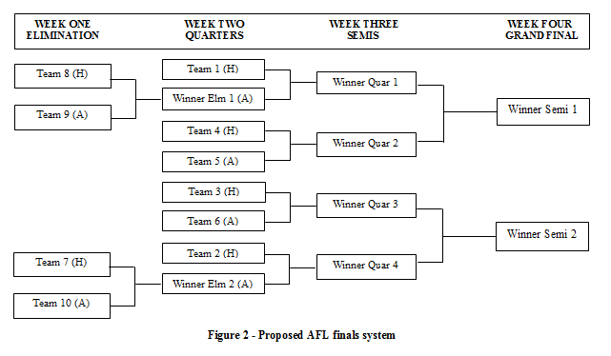
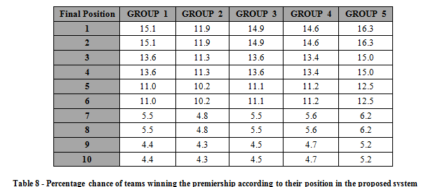
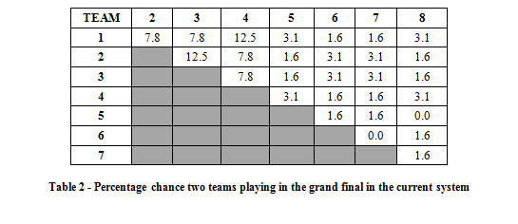
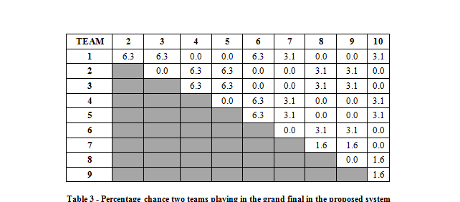
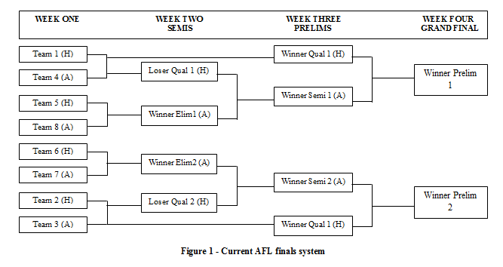
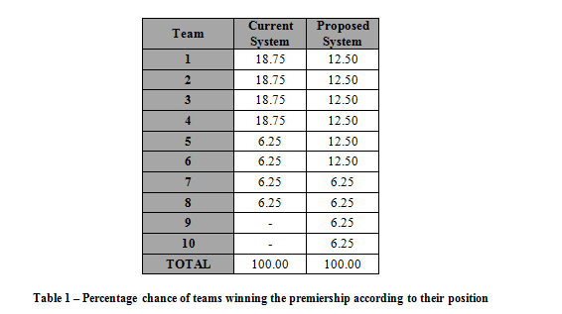
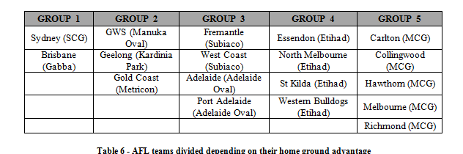
A NEW FINALS SYSTEM FOR THE AFL – How do 10 teams play in 4 weeks?
MATH2223 Exemplar
RMIT University, Melbourne, Australia.
Introduction
The proposed AFL finals system
Using the equal probabilities analysis, a number of other important findings were compared:
The percentage chance that two teams will face each other in the grand final
The expected final position of each team and their percentage chance at finishing in any position
Using these groups, and the different possibilities, the percentage chance of winning the premiership can be recalculated using the home ground advantage.
When compared to Table 1, groups 1, 3 and 4 have similar values. Group 2 can be seen to suffer the most when using the home ground advantage model and this is because the teams in this group will never have a home ground advantage. They would either play away or at a neutral venue, which is obviously quite disadvantageous.
The group which benefited the most out of this home ground advantage model was group 5. The percentage chances of winning the premiership increased throughout all the positions with this method due to the fact that their home ground was the home of the grand final, and therefore, they were guaranteed a home final, unless they played a team in the same group.
There are many requirements when fulfilling a finals system. Although the proposed format of a top 10 is quite similar to that of the current system, there are a number of flaws. In terms of percentage chance, there is no difference if a team is first or sixth, as they all have the same probability of winning the premiership. This flaw can also be seen in the current system. Convincing the public of this new system will be difficult as it does not reward the teams who finished on top at the end of the home and away season. Further analysis of this format, along with other formats should be analysed with a focus on rewarding the teams on top.
S. R. Clarke, “Calculating Premiership Odds by Computer: An analysis of the AFL final eight playoff system”, Swinburne University, Victoria, Australia (1995), J. Lowe & S. R. Clarke, “An analysis of the AFL Final Eight System”, Swinburne University, Victoria, Australia (2000), “AFL finals system”, 2014, site: [http://www.topendsports.com/sport/afl/afl-final-system.htm] (viewed 11th June 2015), “AFL Match Statistics”, 2014, site: [http://www.afl.com.au/stats] (viewed 11th June 2015)
The Australian Football League (AFL) is one of the leading sports in Australia. One of the major reasons for its success is the entertaining final series played out after a long season. After 22 gruelling rounds, the top teams fight it out to be crowned the premiers. Over the years, the final series format has changed to accommodate the increasing number of teams involved in the premiership.
Over the years, the format has changed a number of times. In 2000, a new Top 8 system was introduced, still with a focus on giving the top teams an advantage. It is now 2015, and the same system is still in place. Unlike the 16 teams competing in the year 2000, there are now 18 teams, with the Gold Coast Suns (2011) and Greater Western Sydney (2012) playing in the premiership. The increased number of teams in recent years has now caused many in the AFL world to ponder whether a new system should be introduced for the finals, one which allows for more teams to fight it out in the finals. One of these systems being considered is a Top 10 final series.
This study will analyse a proposed Top 10 system and how it compares to the current Top 8 system being employed
5
The proposed AFL finals system consists of the top 10 teams in the league to play 9 games played over four weeks. It can be seen that the amount of games and weeks played are the same as the system currently employed. In this format, the top six teams will have a bye whilst the bottom four will play an elimination final, with the winning team moving into the second week. From then on, the format will be in the form of a knockout competition, with no teams getting a second chance.
The current AFL finals system
Performance of new system using equal probabilities
There are many differences in regards to the percentage chance of two teams playing each other when comparing the two systems. Due to the nature of the current system where top teams have a double chance, a lot more combinations are possible.
Two methods of analysis were used:
Assuming both teams in a match have an equal chance of winning any game at any venue. Therefore, both teams have a 50% chance of winning.
Assuming that a home ground advantage value is used to determine the probability of winning.
The equal probabilities model assumes each team in any round has a 50% chance of winning. Lowe & Clarke (2000) have analysed this for the current season and it is compared against the proposed top 10 system, as seen below:
Conclusion
Performance of new system using home ground advantage
The next type of model focuses on including the home ground advantage. It is assumed that home teams do have an advantage when playing at their own ground, and to allow for a more reliable analysis, this is required. After going through the 2014 AFL Premiership results (AFL Match Statistics, 2014), it was observed that 56% of home teams would win when playing at home.
Teams were divided in terms of their home grounds:
References
4

